Slide 1
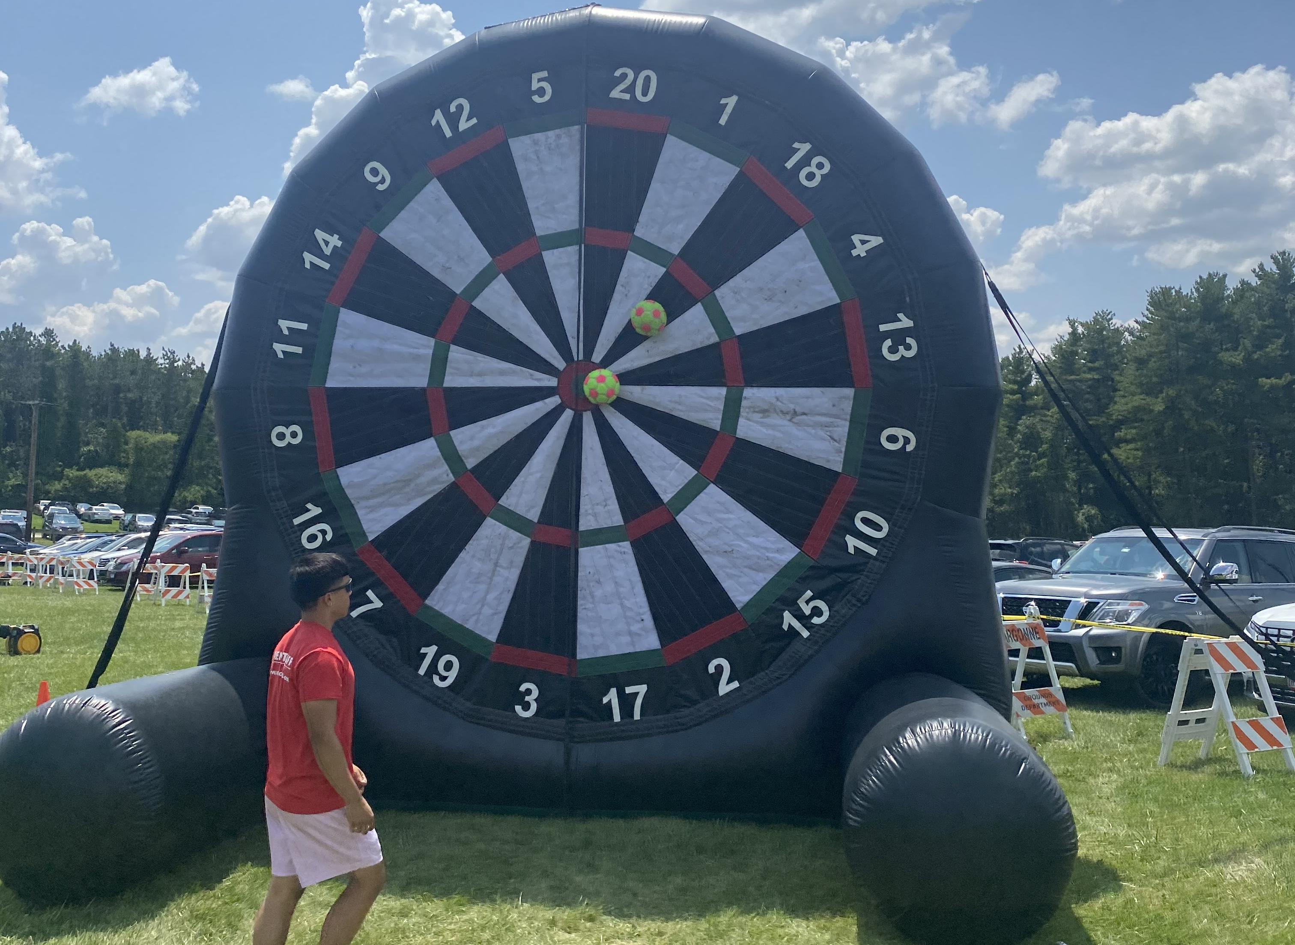
7/27/2023 Updates:
Cleaned up growth_app folder and created multi_growth_app_folder
Made my poster!
Completed 6-well and 12-well dry runs!
Learned about how to create Globus functions and beginning to work within C2Flow
Future Goals:
Complete SULI Paper Report
Smooth out actions in picking up plates in stack of 12
Finish 12 Hour Wet Run This Week
Successfully make a 12 Hour Cells Run Next week
C2Flow – Process data transferred to Hidex and create funcx “Line_of_best_fit” to calculate slope of line of best fit for Arvind’s group
Show download csv file on Globus Portal
Alp Demirtas

Slide 2
7/20/2023 Updates:
Single Plate uploaded to Globus correctly! Can now access Globus files to process data from
Developed and tested code that finds experiment on SDL BIO portal, reads experimental results, and finally processes it into an Excel file for convenience
Finished writing my poster!
Smoothed out some PlateCrane movements within structure and upload to Globus
Vibe For the Upcoming Week:
Time to Cook! I want to begin synthesizing the features I developed in parallel for the growth curve application into multiple-plate runs
Future Goals:
Use developed code architecture to write a growth assay that starts with human input (4 plates) and then trains AI model to run 8 more plates
Complete SULI Paper Deliverable and Record Poster Presentation
Add the ability to capture line of best fit from experimental data for Ramanathan group’s AI model
Run 6 multi-plate cell run this week
Alp Demirtas

Slide 3
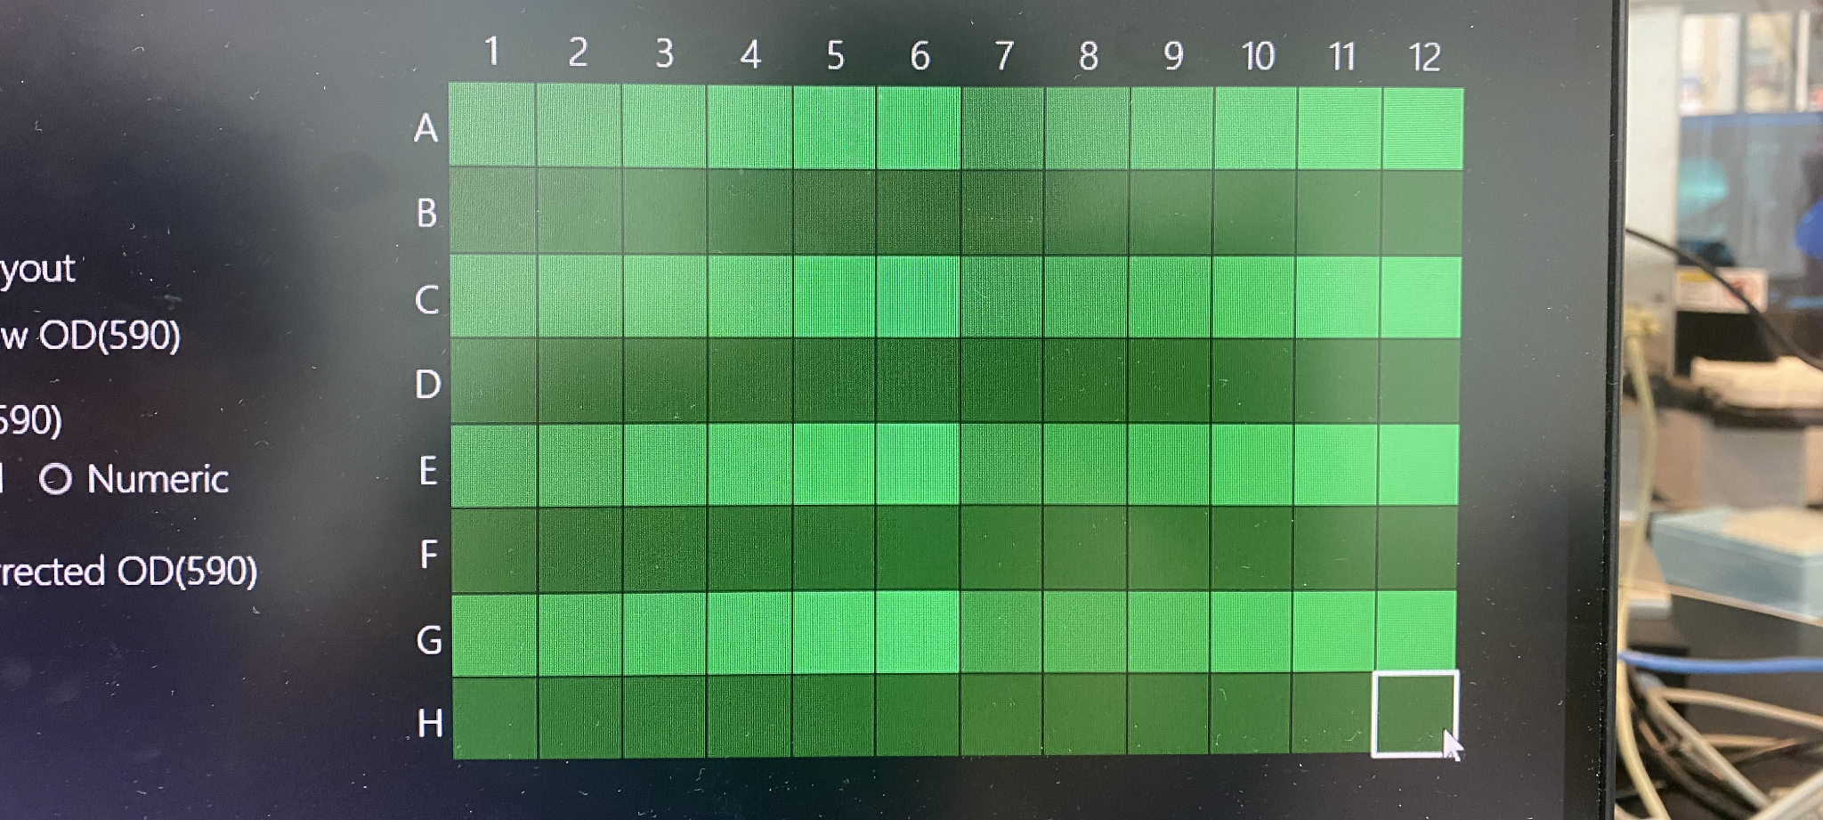
7/12/2023 Updates:
Ran first cells test!
Fixed positioning on Hudson Solo index
Ran 6 well plate on experiment setup with updated Excel structure
Developed full architecture for multiple well Plates and placeholder AI structure
Future Goals:
Use developed code architecture to write a growth assay that starts with human input (4 plates) and then trains AI model to run 8 more plates
Smooth out some PlateCrane movements within structure and upload to Globus
Complete SULI deliverables - poster, paper, etc.
Talk with Ramanathan group to see what elements I can add to the structure to help transitioning their AI software
Run multi-plate cell run next week
Final Form of Project: Showcasing BIO workcell setup with human/AI combination of Multiple Growth Cells
Alp Demirtas

Slide 4
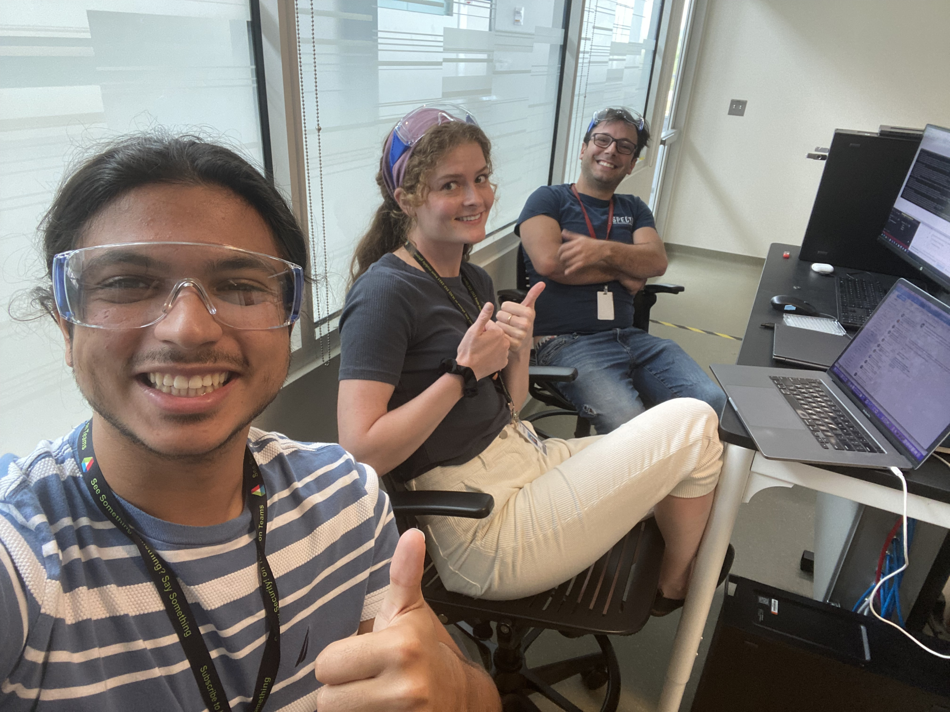
7/5/2023 Updates:
Hidex client finally works in 12–hour run! – Filtered IP address of anything in socket but Potts
Created master Excel document structure for scientists to prepare their run
Read Excel document data into Multi-Loop Run payload
Scientists’ Perspective on Growth Assay
How will they be starting the run?
Is there a website they will input their desired culture and media combinations or is Excel template fine?
Will we need to be able to search for previous runs?
On Globus/On Local Computer?
How would our barcoding look like? Should ID names for files indicate the time of experimental run start?
What features would we want to incorporate within the structure of our experiment?
Future Goals:
Run single-well plate experiment with cells
Fix positioning on Hudson Solo Index 2
Run 6 well plate on experiment setup and updated Excel structure
Incorporate VERY BASIC placeholder AI model into code structure
When the HIDEX finally runs a 12-hour test
Alp Demirtas

Slide 5
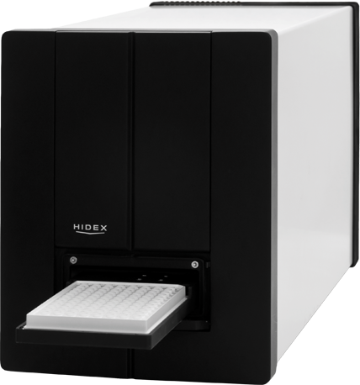
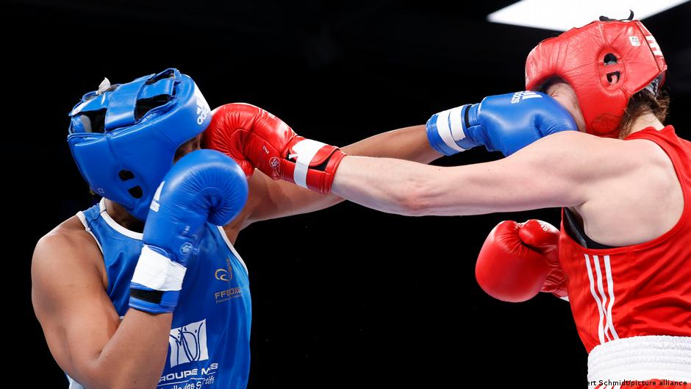
6/29/2023 Updates:
Journal Club Presentation Went Well!
Learned C# Scripts, Sockets, and Hidex Client
Me vs. Hidex (Round by Round) Round One
Hidex: Overwhelmed by pinging
Response: Global action in process boolean and global static client with defined address
Round Two
Hidex: Stuck on accept state in socket and abandoned mutex error
Response: Created TCPlistener class
Round Three
Hidex: Forcibly closed by host error
Response: Polled before receiving data to assess if RST packet is being sent
Future Goals:
Get the Hidex client running in a 12 hour “REAL CELLS TEST” without problems
Begin to create infrastructure to house AI-based runs (“Barcoding” plates, reading stock Solo columns from experiment level to the workflow )
Alp Demirtas

Slide 6
6/22/2023 Updates:
Debugged Multi-Workflow Architecture + Ran 2 Plates Yesterday Without Code Breaking!
Couple Observations: (1) LidNest indices are weird and (2) Plate Crane can’t pick up Solo 3 tip box
Wrote Journal Club Presentation on BacterAI, Michigan-based AI Software that “Closes the Loop”
Learned from Paper to Outline Larger Structure for Closing the Loop
Larger Structure to Close the Loop (Developing as I Learn):
Load AI model structure into program (From Globus if able to do so or locally on computer)
Use AI model to determine up to 12 combinations of antibiotic, cell type, and concentration
corresponding to optimal cell growth, or lack thereof, and save these combinations into their respective arrays
Execute the multi-run experiment, with the payload for the Hudson Solo using respective array values for each iteration
Transfer T0 and T12 Hidex data from Hudson Client to Potts and then publish data to Globus
Read Hudson data from Globus if able to do so or locally
Re-train the AI Model structure on new data
Upload AI model to wherever it is being stored (From Globus if able to do so or locally on computer)
Set up new experiment and repeat steps 1-7 ← Only Step With Human Involvement
Future Goals:
Testing Multiple Plates (6 Plates, 12 Plates)
Further Develop Globus Data Reading Structure and Machine Learning
Implement learning algorithm to close the loop: How would we be collaborating with Dr. Arvind’s group for this?
Alp Demirtas

Slide 7
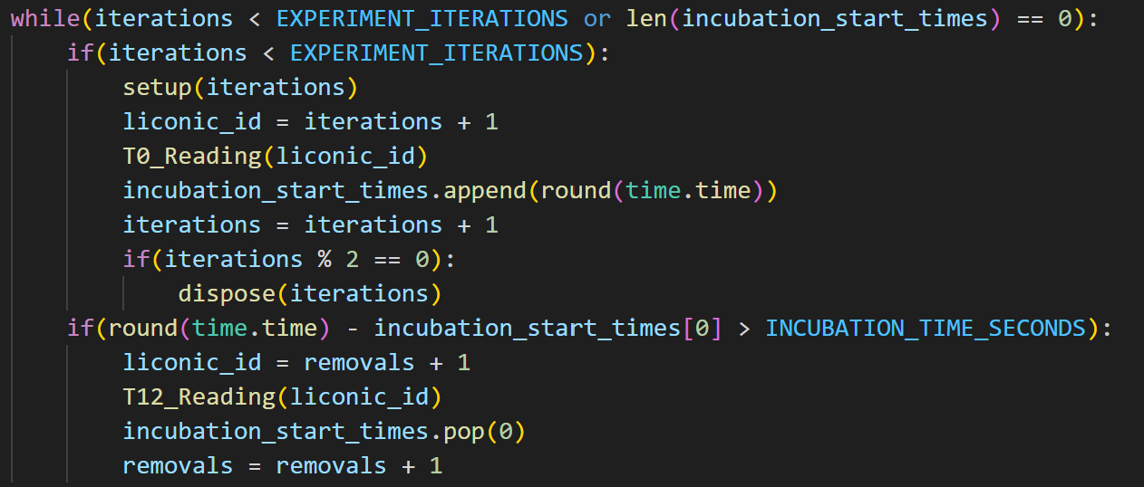
6/14/2023 Updates:
Implemented Tip Refill Script in C# - now successfully part of BIO workflow
Developing Multi-Run Code + Workflow that Can Hold Up to 12 Plates
Learned about Globus Data Transfer
Multi-Run Code
For each Loop:
IF WELL PLATES REMAIN:
1. Setup the Hudson Experiment
Always provides a 96 well and places top in Stack 1
If iterations is even, tip box and dilution deep well as well
If iterations is factor of 6, growth media deep well as well
2. Conduct Experiment to Incubation
3. “Dispose” of Used Materials
If total removals is even, gets rid of tip box and serial dilution plate
If total removals is factor of 6, dispose growth media deep well as well
Future Goals:
Testing Multiple Plates Up to 12 Plates
Implementing Data Reading from Globus
Learn about Machine Learning and AI to close the loop
Create a basic ML code for the BIO workcell
IF PLATES IN INCUBATOR + T12:
4. Conduct T12 Reading from designated plate ID + remove incubation start time once done
Alp Demirtas

Slide 8
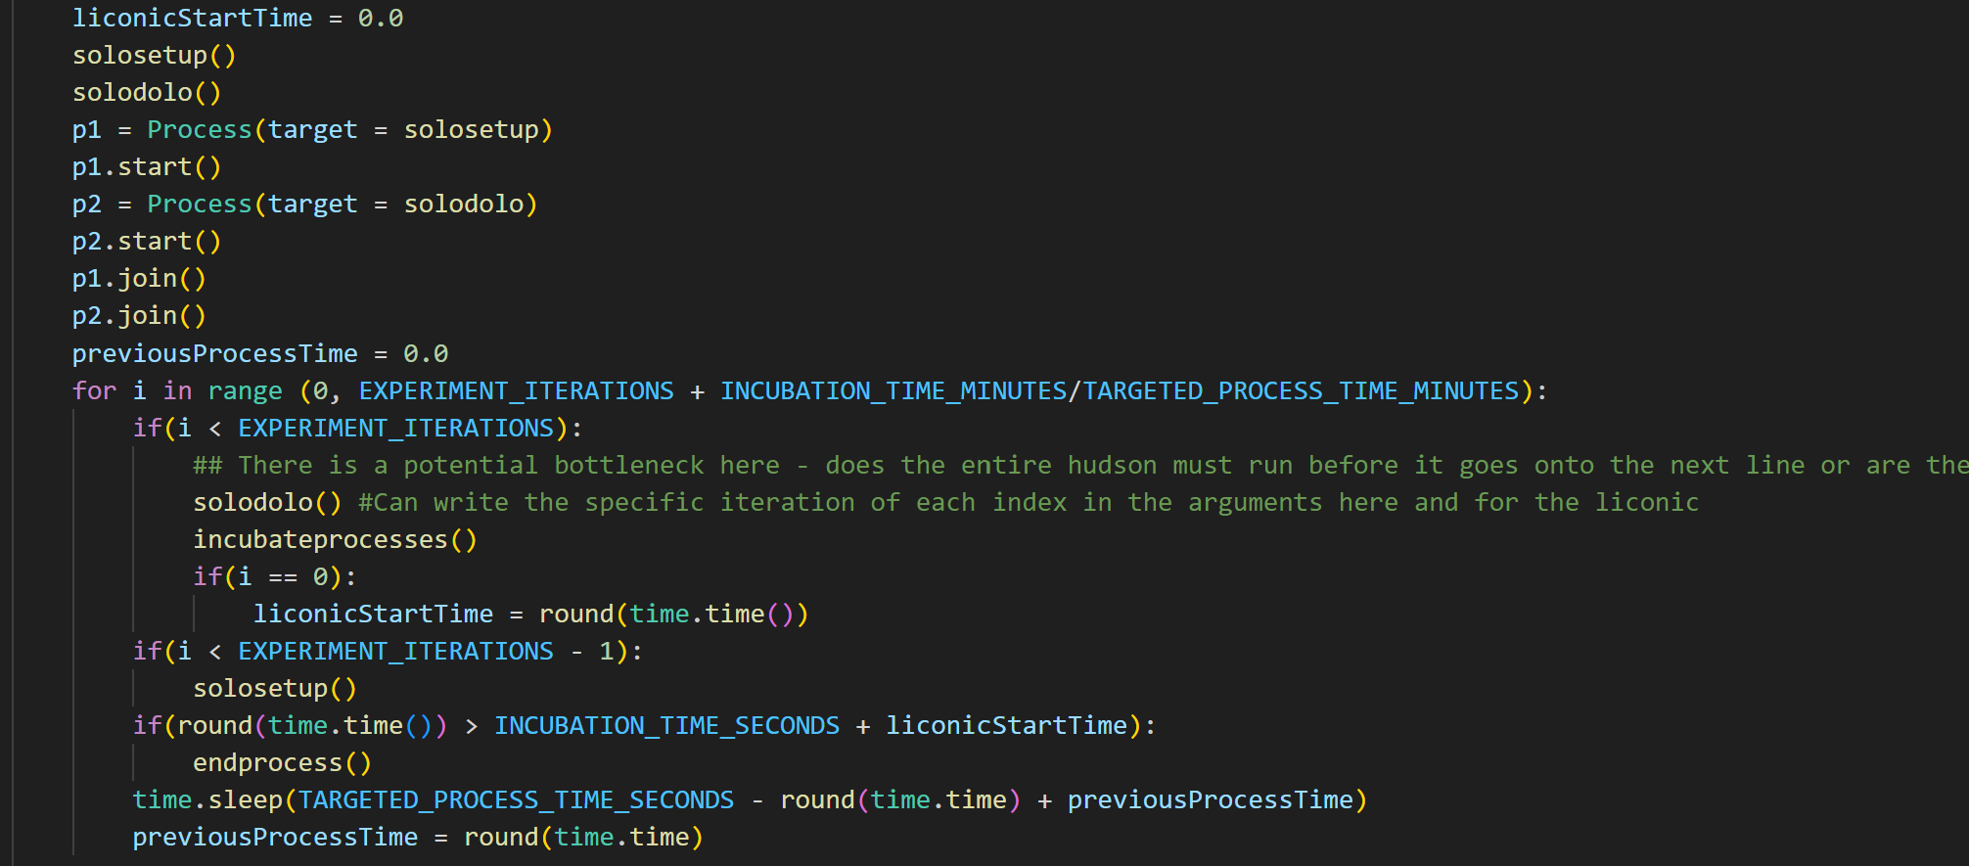
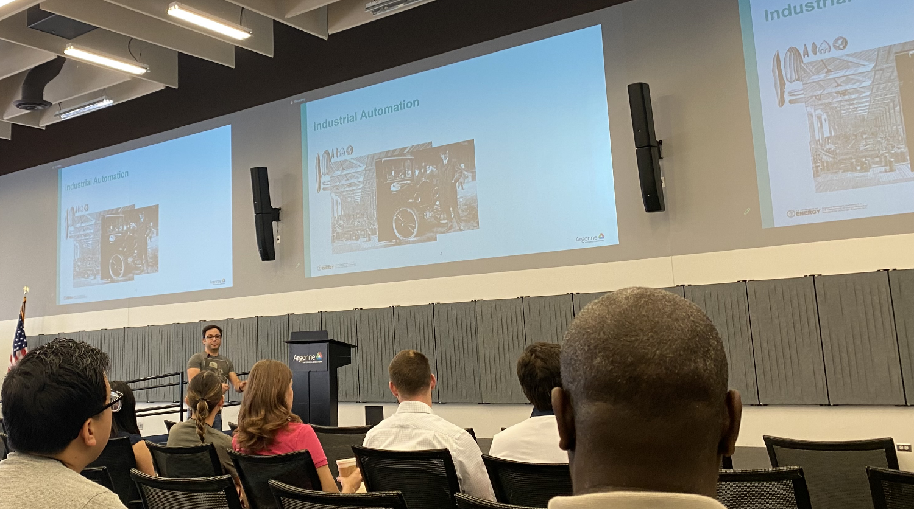
Multiple Loops + Parallelization:
Updates:
Executed Basic Workflow + Learned About In-depth Procedures using Wei
Completed Training Modules
Created C# Script for Sending Tip Refilled Command to Hudson Solo
Unsure where to execute this, Hudson script makes sense and is currently C#, but we want to write it in Python
Developed First and Second Iteration Code to translate Bio Workflow into Parallel Workflow
Executing Tasks in Parallel to Optimize Time Spent for Multiple Wells
Current Setup:
Zero State:
1. Transfer to Hudson
2. Hudson Experiment
3. Set Aside Well Plate
Every Other State:
1. Transfer to Hudson
2. IN PARALLEL:
Hudson Experiment AND Transfer Aside to Incubator if present then Read another plate after incubator if after incubation time and present
3. Set Aside Well Plate
Questions + Concerns:
Worried about PlateCrane hitting Solo since they are working at the same time, especially during incubation. Is there a way to mitigate this?
Is there a way I can receive GitHub Access? Currently, I am not able to push and pull to branches.
Future Steps:
Learning about Globus, Further Testing Parallel Structure, Data Analytics from Hidex to Eventually Close Loop
Hey Raf!

Slide 9
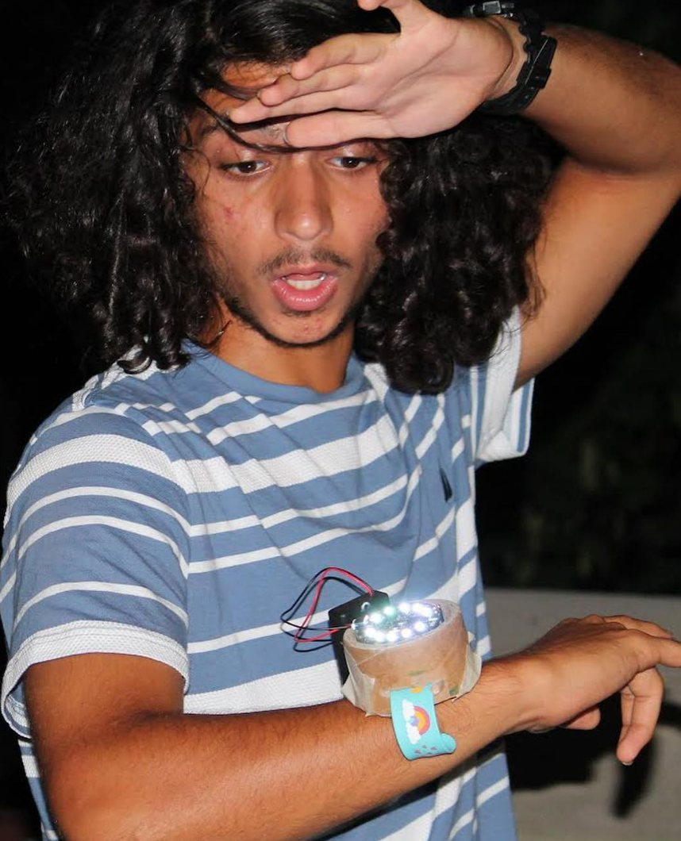
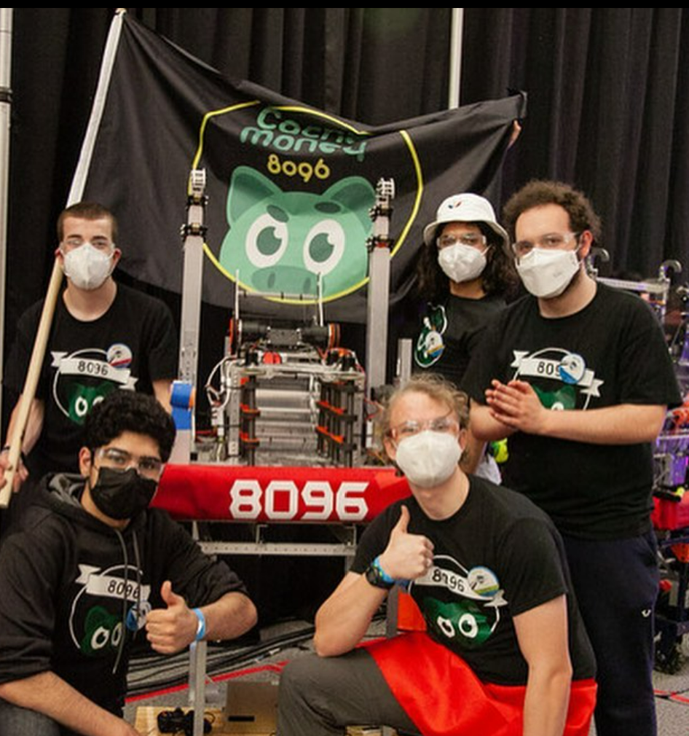
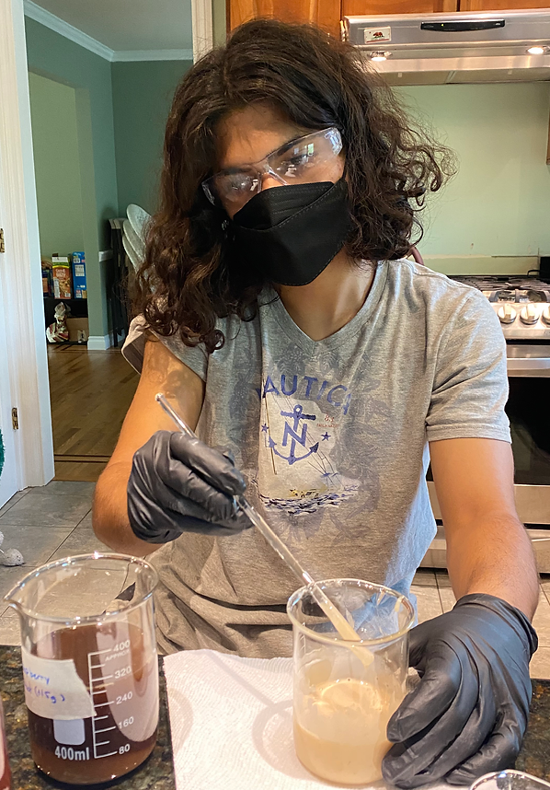
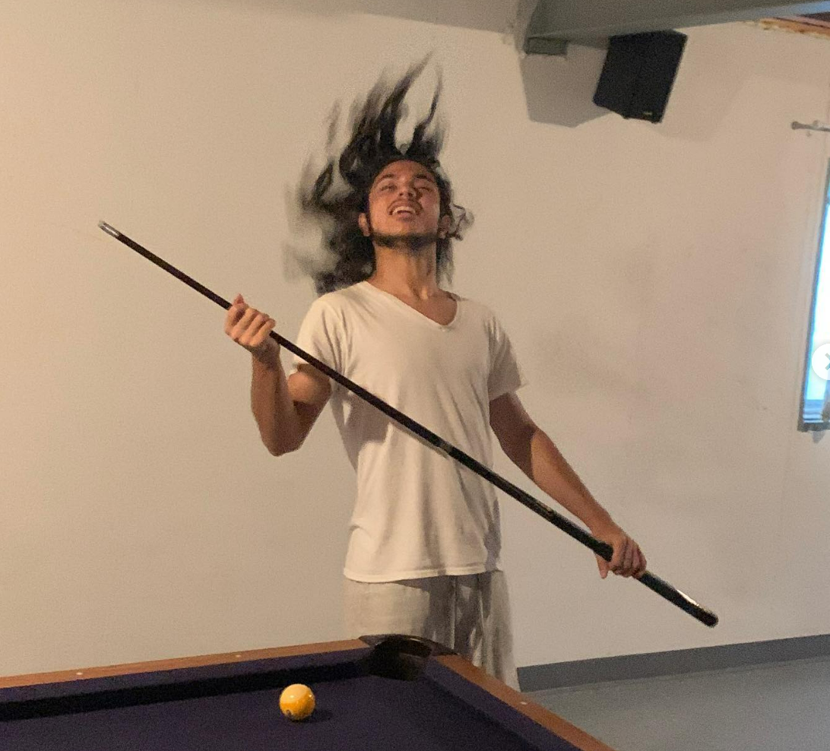
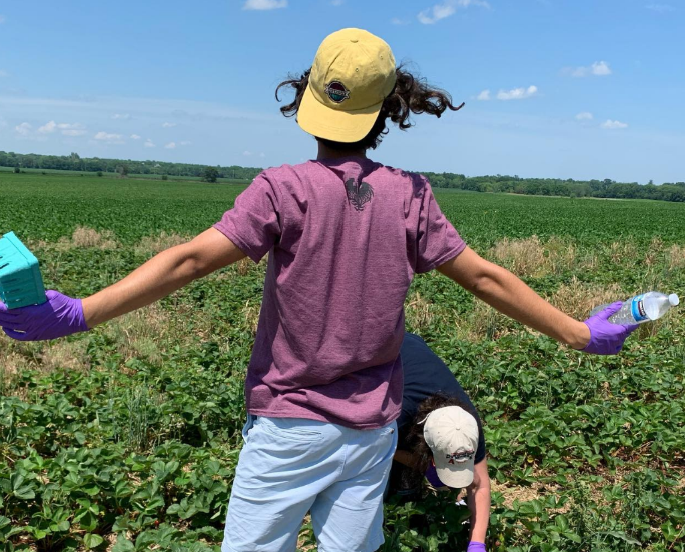
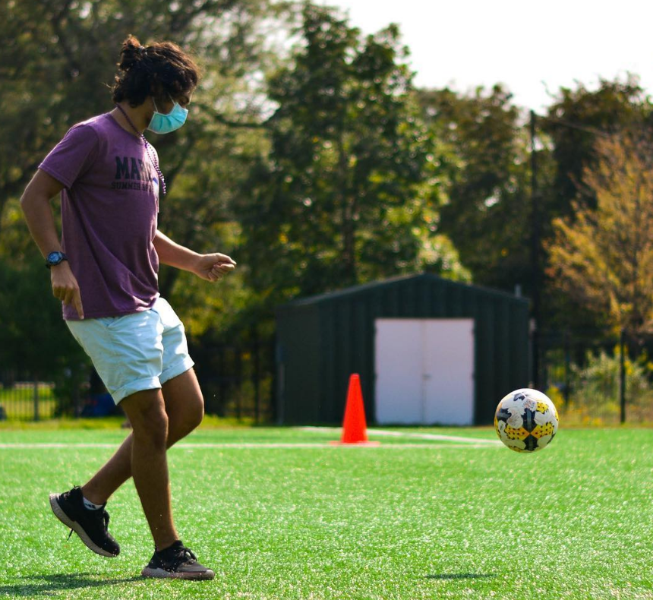
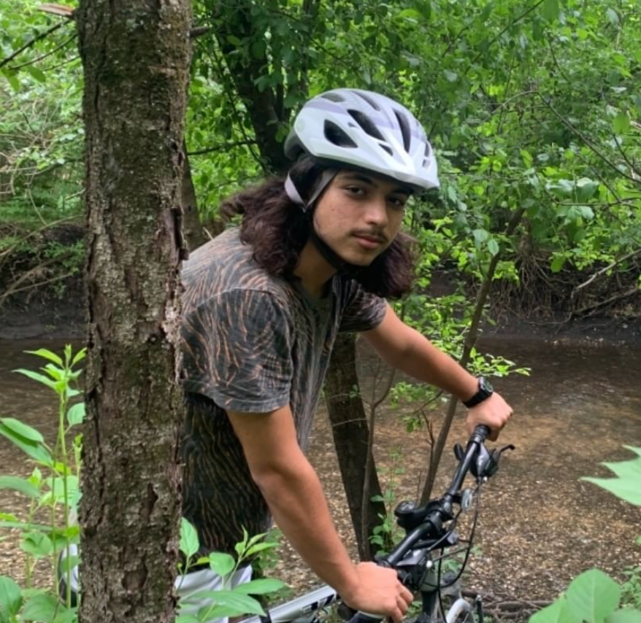
Fun Fact: I am is the shortest sentence in the English language.
I’m Alp!

Slide 10
Current Progress
Next Steps
High-level Familiarity with Workflow at Bio and RPL Workcell
Training Modules & Delving Deeper into Programming Module
Goals:
Have a lot of fun!
Achieve an Integrated Workflow System in Bio Workcell
Learn about SDL Interface Mechanisms + Various Projects in RPL and Bio Departments
Contribute to Publishing a Paper Based on Findings

